Slide 1
Unit 4: Disaster Medical Operations – Part 2
CERT Basic Training

Slide 2
Unit 3 Review
What techniques are available to aide in the control of bleeding?
What is the first action to take when approaching a survivor?
When approaching a survivor, what are the 3 things to do before treatment?
What is the correct way to position a patient to keep the airway clear?
CERT Basic Training Unit 4: Disaster Medical Operations – Part 2
4-1
Notes:
Direct pressure, compression bandage, tournequet
Safety - scene size-up
Introduce, affiliation, ask permission to treat
Recovery position

Slide 3
Triage Review Activity
Notes:
Use the triage cards for a quick triage review to ensure understanding from prior week

Slide 4
Cold-Related Injuries
Hypothermia:
  Occurs when body’s temperature drops below normal
Frostbite:
  Occurs when extreme cold shuts down blood flow to extremities, causing tissue death
PM 3-16
CERT Basic Training Unit 3: Disaster Medical Operations – Part 1
3-38

Slide 5
Symptoms of Hypothermia
Body temperature of 95°F or lower
Redness or blueness of skin
Numbness and shivering
Slurred speech
Unpredictable behavior
Listlessness
PM 3-16
CERT Basic Training Unit 3: Disaster Medical Operations – Part 1
3-39

Slide 6
Hypothermia Treatment
Remove wet clothing
Put something under the patient
Keep them sheltered and/or covered
Do not attempt to use massage
Place in the recovery position if unconscious
PM 3-16
CERT Basic Training Unit 3: Disaster Medical Operations – Part 1
3-40

Slide 7
Symptoms of Frostbite
Skin discoloration
Burning or tingling sensation
Partial or complete numbness
PM 3-16
CERT Basic Training Unit 3: Disaster Medical Operations – Part 1
3-41

Slide 8
Frostbite Treatment
Immerse injured area in warm (NOT hot) water
  Warm slowly!
Do not allow part to re-freeze
Do not attempt to use massage
Wrap affected body parts in dry, sterile dressing
PM 3-16
CERT Basic Training Unit 3: Disaster Medical Operations – Part 1
3-42
Notes:
Note – mention having a first aid book at home

Slide 9
Heat-Related Injuries
Heat cramps
  Muscle spasms brought on by over-exertion in extreme heat
Heat exhaustion
  Occurs when exercising or working in extreme heat results in loss of body fluids
Heat stroke
  Survivor’s temperature control system shuts down
  Body temperature rises so high that brain damage and death may result
PM 3-17
CERT Basic Training Unit 3: Disaster Medical Operations – Part 1
3-43

Slide 10
Symptoms of Heat Exhaustion
Cool, moist, pale or flushed skin
Heavy sweating
Headache
Nausea or vomiting
Dizziness
Exhaustion
PM 3-17
CERT Basic Training Unit 3: Disaster Medical Operations – Part 1
3-44

Slide 11
Symptoms of Heat Stroke
Hot, red skin
Lack of perspiration
Changes in consciousness
Rapid, weak pulse and rapid, shallow breathing
PM 3-17
CERT Basic Training Unit 3: Disaster Medical Operations – Part 1
3-45

Slide 12
Treatment of Heat-Related Injuries
Remove from heat to cool environment
Cool body slowly
Have the heat exhaustion patient drink water, SLOWLY
Do not provide food or drink to the patient if he or she is experiencing vomiting, cramping, or is losing consciousness
PM 3-18
CERT Basic Training Unit 3: Disaster Medical Operations – Part 1
3-46

Slide 13
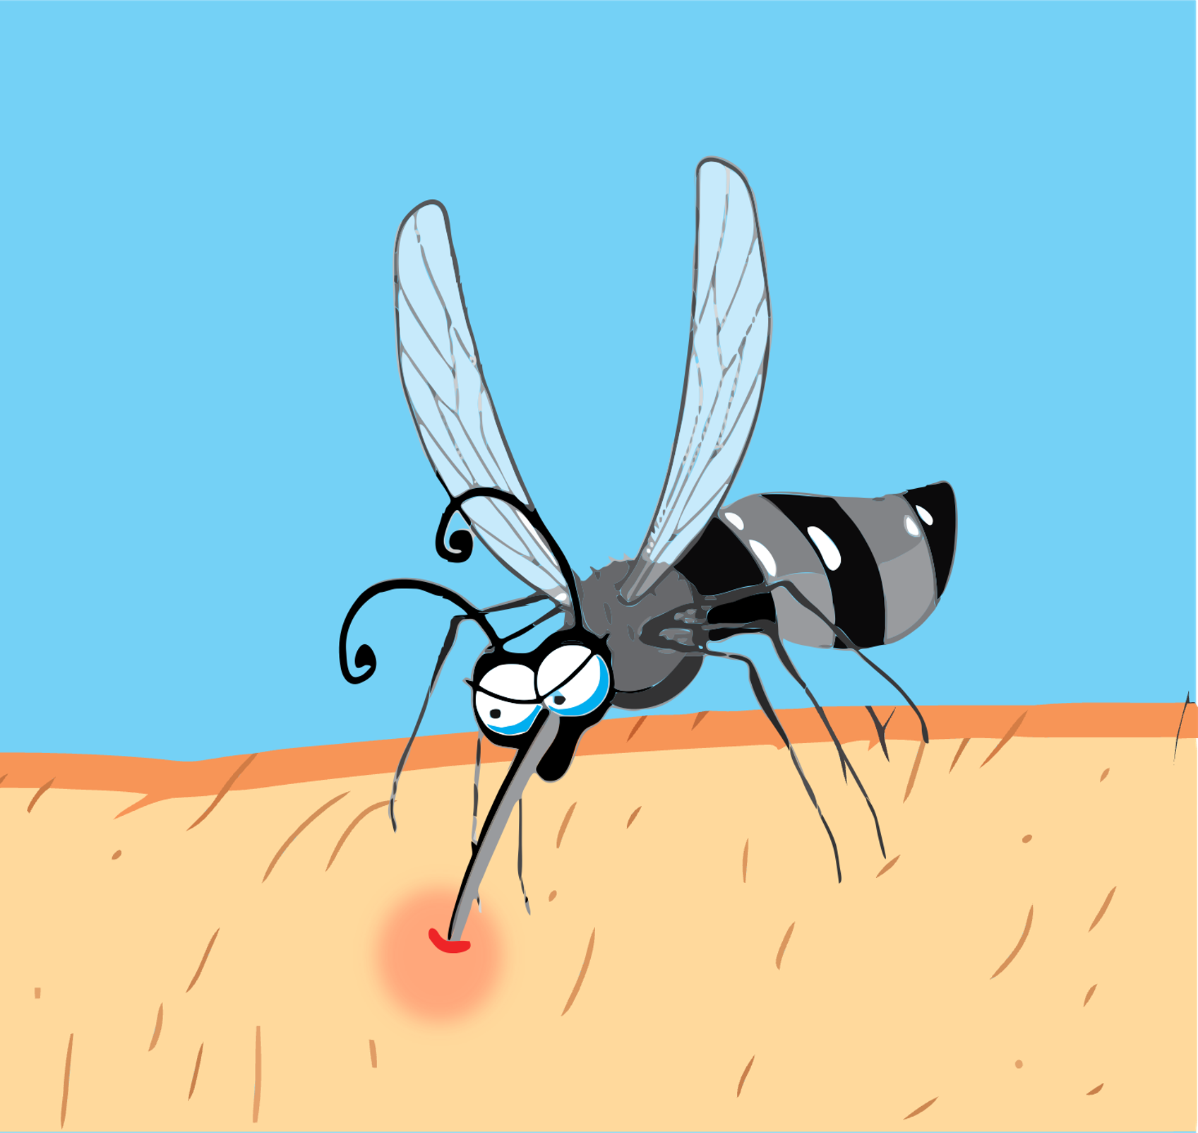
Treatment for Bites/Stings
If bite or sting is suspected, and situation is non-emergency:
  Remove stinger if still present by scraping or flicking to remove stinger
  Wash site thoroughly with soap and water
  Place ice on site for 10 minutes on and 10 minutes off
PM 3-18
CERT Basic Training Unit 3: Disaster Medical Operations – Part 1
3-47

Slide 14
Anaphylaxis
Calm the individual
If possible, find and help administer the patient’s Epi-pen
  Many severe allergy sufferers carry one at all times
Do not administer medicine aside from the Epi-pen
  This includes pain relievers, allergy medicine, etc.
PM 3-18
CERT Basic Training Unit 3: Disaster Medical Operations – Part 1
3-48
Notes:
***Discussion that we do not administer drugs***

Slide 15
Unit 4 4 Objectives
Explain the role of the CERT volunteer during a mass casualty incident
Describe the functions of disaster medical operations
Describe how to set up survivor treatment areas
Perform head-to-toe patient assessments
Take appropriate sanitation and hygiene measures to protect public health
PM 4-1
CERT Basic Training Unit 4: Disaster Medical Operations – Part 2
4-3

Slide 16
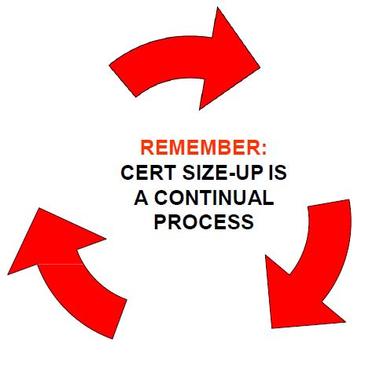
CERT Size-up
Gather Facts
Assess Damage
Consider Probabilities
Assess Your Situation
Establish Priorities
Make Decisions
Develop Plan of Action
Take Action
Evaluate Progress
PM 2-8
CERT Basic Training Unit 4: Disaster Medical Operations – Part 2
4-2

Slide 17
Mass Casualty Incidents
Incidents in which the number of casualties overwhelms the local resources
  Multi-car or bus accident
  Building collapse
  Natural disasters (e.g., earthquakes or fires)
PM 4-2
CERT Basic Training Unit 4: Disaster Medical Operations – Part 2
4-4

Slide 18
Role of First Responder Personnel of 2)
First responders are Fire, Law, Medical Transport, Utilities (PG&E)
During mass casualty events, first responder personnel will:
  Establish command and control of the incident area
  Conduct a scene size-up and set-up
  Send survivors with relatively minor injuries to a holding area to await treatment
  Identify survivors who require life-saving interventions and treat them immediately
PM 4-2
CERT Basic Training Unit 4: Disaster Medical Operations – Part 2
4-5

Slide 19
Role of First Responder Personnel (2 of 2)
During mass casualty events, first responders will also:
  Identify deceased victims as well as survivors too severely injured to save
  Manage medical transportation for survivors who require additional treatment
  Secure the area to protect first responders, survivors, and evidence for law enforcement investigations
  Remove debris and other safety or health threats
PM 4-2
CERT Basic Training Unit 4: Disaster Medical Operations – Part 2
4-6

Slide 20
Role of CERT Volunteers (1 of 2)
First take care of yourself, family, and neighbors in a disaster
If a first responder is not available, assess the situation and determine whether you can provide life-saving interventions
If activated:
  Don PPE
  Follow ICS & CDC protocols if it is safe to do so
    Interface with Fire Branch Manager or Team Leader
PM 4-2
CERT Basic Training Unit 4: Disaster Medical Operations – Part 2
4-7
Notes:
Note – original sllde had us donning PPE and walking up to the first responders to help. NOPE – not here!

Slide 21
Role of CERT Volunteers (2 of 2)
When meeting with first responders, provide them with detailed information from your size-up. Ask how you may be of assistance
  Follow instructions
  For your safety, first responders may ask you to leave the area
  If part of a team, follow chain of command
  If on your own, report the incident and your role to your CERT Team Leader and local agency CERT affiliation
Communication is key for supporting first responders
PM 4-2
CERT Basic Training Unit 4: Disaster Medical Operations – Part 2
4-7

Slide 22
Functions of Disaster Medical Operations
Triage/Assessment
Treatment
Transport
Morgue
Supply
PM 4-4
CERT Basic Training Unit 4: Disaster Medical Operations – Part 2
4-8

Slide 23
Establish a Medical Treatment Area
Select site and set up treatment area as soon as injured survivors are confirmed
When determining best location(s) for treatment area, consider:
  Safety of rescuers and survivors
  Ease of access to resources
PM 4-5
CERT Basic Training Unit 4: Disaster Medical Operations – Part 2
4-9

Slide 24
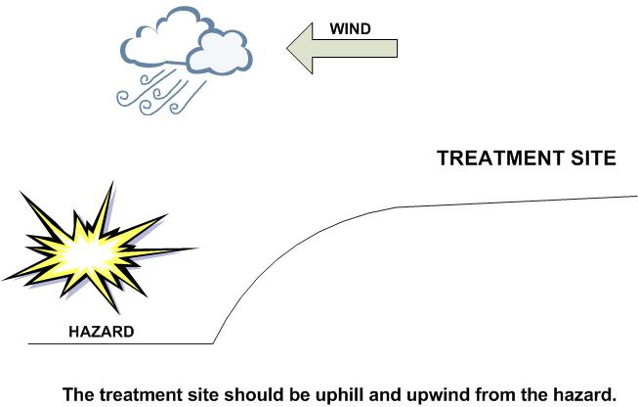
Medical Treatment Areas
The site selected should be:
  In a safe area, free of hazards and debris
  Upwind, uphill, and upstream (if possible) from hazard zone(s)
  Accessible by transportation vehicles
  Expandable
PM 4-5
CERT Basic Training Unit 4: Disaster Medical Operations – Part 2
4-10
Notes:
We added this slide back in

Slide 25
Medical Treatment Areas
To help meet the challenge of limited resources, CERT may need to establish:
  - Decentralized Treatment Areas (more than one location)
  - Centralized Treatment Areas (one location)
PM 4-5
CERT Basic Training Unit 4: Disaster Medical Operations – Part 2
4-10
Notes:
Must be accesible to transport and expandable

Slide 26
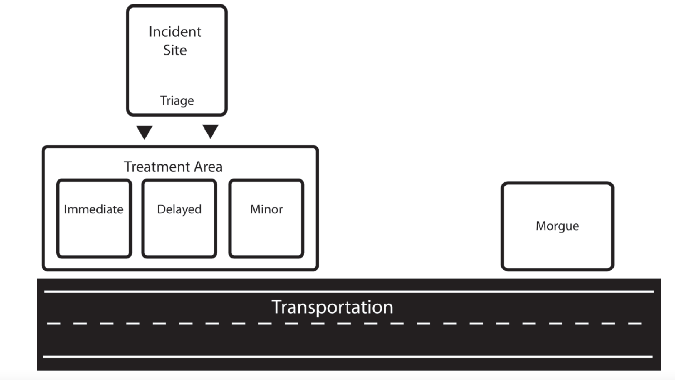
One thing wrong with this
Notes:
One thing wrong with this – Switch Immediate and minor. Why? (Don’t want to carry deceased past others) Best place for medical supplies? (between I & D)

Slide 27
Medical Treatment Areas
Light damage: assess in place
Moderate damage: move to treatment area first
Assess and tag everyone
Both verbal and hands on assessment
PM 4-5
CERT Basic Training Unit 4: Disaster Medical Operations – Part 2
4-10
Notes:
Add image

Slide 28
Safety for Rescuers and Survivors
In structures with light damage:
  Treat life-threatening injuries onsite
  Assess survivors where they are found
  Further medical treatment is performed in a safe location
In structures with moderate damage:
  Treat life-threatening injuries onsite
  Assess survivors in a safe location outside the building
  Survivors are sent to a medical treatment area
  Individual safety is the number one priority
PM 4-5
CERT Basic Training Unit 4: Disaster Medical Operations – Part 2
4-11

Slide 29
Safety for Rescuers and Survivors
In structures with heavy damage:
  CERT members do NOT enter
  Individual safety is the number one priority
PM 4-5
CERT Basic Training Unit 4: Disaster Medical Operations – Part 2
4-11

Slide 30
Head-to-Toe Assessment
Objectives of head-to-toe assessment:
  Determine extent of injuries
  Determine type of treatment needed
  Document injuries
PM 4-7
CERT Basic Training Unit 4: Disaster Medical Operations – Part 2
4-12

Slide 31
DCAP-BTLS
PM 4-8
CERT Basic Training Unit 4: Disaster Medical Operations – Part 2
4-13
Notes:
Find better images

Slide 32
DOTS
Deformities
Open wounds
Tenderness
Swelling
PM 4-8
CERT Basic Training Unit 4: Disaster Medical Operations – Part 2
4-13
Notes:
Next slide is Video Head to Toe assessment with LAPD Stacey Gerlick

Slide 33

Video
PM 4-8
CERT Basic Training Unit 4: Disaster Medical Operations – Part 2
4-13

Slide 34
Conducting Head-to-Toe Assessment
Pay careful attention
Follow CDC COVID guidelines for approaching survivors
Wear PPE
Look, listen, and feel
Suspect a spinal injury in unconscious survivors and treat accordingly
Check own hands for patient bleeding
PM 4-8
CERT Basic Training Unit 4: Disaster Medical Operations – Part 2
4-14

Slide 35
Order of Assessment
Head
Neck
Shoulders
Chest
Arms
Abdomen
Pelvis
Legs
PM 4-8
CERT Basic Training Unit 4: Disaster Medical Operations – Part 2
4-15
Notes:
Keep this slide up while folks pair up and do H2T

Slide 36
Activity
In groups of 2 or 3
Conduct Head to Toe Assessment, remembering the order of assessment

Slide 37
Closed-Head, Neck, Spinal Injuries
If injuries to the head or spine are suspected, do no harm
  Minimize movement of head and neck
  Rigid surface
If survivors exhibit signs or are found under heavy debris, treat them as having a closed-head, neck, or spinal injury
PM 4-8
CERT Basic Training Unit 4: Disaster Medical Operations – Part 2
4-16
Notes:
Review list on 4 – 9 in Participant Manual

Slide 38
Public Health Considerations
Maintaining proper hygiene
Maintaining proper sanitation
Purifying water (if necessary)
Preventing spread of disease
PM 4-11
CERT Basic Training Unit 4: Disaster Medical Operations – Part 2
4-17

Slide 39
Maintaining Hygiene
Wash hands frequently
  Or use alcohol-based hand sanitizer
Wear non-latex exam gloves
  10 to 1 bleach solution
Keep dressings sterile
Wash areas that come in contact with body fluids
If it is warm and wet and is not yours, don’t touch it!
PM 4-11
CERT Basic Training Unit 4: Disaster Medical Operations – Part 2
4-18

Slide 40
Maintain Sanitation
Control disposal of bacterial sources
Put waste products in plastic bags
  Tie off bags and mark them as medical waste
Bury human waste
  Away from water sources
  Document location for future cleanup
PM 4-11
CERT Basic Training Unit 4: Disaster Medical Operations – Part 2
4-19

Slide 41
Water Purification Methods
Boil water for 1 minute
Water purification tablets
Non-perfumed liquid bleach
  8 drops/gal of water
  16 drops/gal if water is cloudy
  Let stand for 30 minutes before use
PM 4-12
CERT Basic Training Unit 4: Disaster Medical Operations – Part 2
4-20

Slide 42
Unit Summary (Unit 4)
After a disaster, CERT volunteers should:
  Stay safe – family first
  Assist in neighborhood
  Wait for activation
  Identify self as CERT and give agency affiliation
  Assess and provide life-saving interventions
  Provide responders with detailed information
  Communication is key
PM 4-13
CERT Basic Training Unit 4: Disaster Medical Operations – Part 2
4-21

Slide 43
Unit Summary Cont’d
Treatment areas
  Central or decentralized
  Uphill, upwind, and upstream
  Safety
  Access to resources
  Expandable
Head-to-toe assessments
  Hands-on and verbal
  Conducted in the same way each time
To safeguard public health, maintain proper hygiene and sanitation, and purify water
PM 4-13
CERT Basic Training Unit 4: Disaster Medical Operations – Part 2
4-21

Slide 44
Homework Assignment (Unit 4)
Read units 6 (Fire Safety and Utilities) and 8 (Terrorism) to be covered in next session
Practice complete head-to-toe assessment on friend or family member
PM 4-13
CERT Basic Training Unit 4: Disaster Medical Operations – Part 2
4-22

